Slide 1
The A Team
Project 1 – Uber Data

Slide 2
Why Uber

Slide 3
The Questions
Does the time/date affect how often people order Uber’s?
How has the prices changed over time?
What distance are people using Uber’s for?

Slide 4


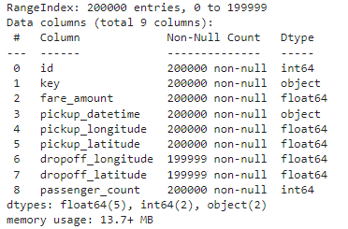
Data Exploration
Our Data
Uber trips in New York 2009 - 2015
Kaggle Dataset

Slide 5
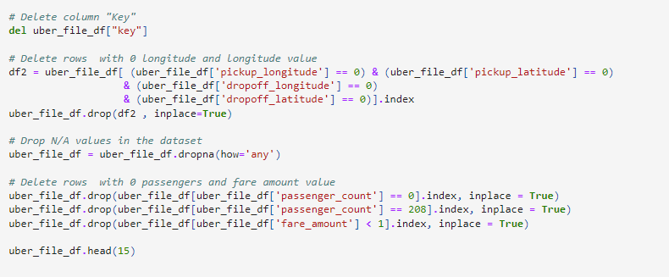
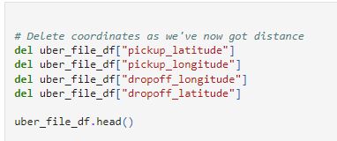

Clean-up process

Slide 6
Analysis Process

Slide 7
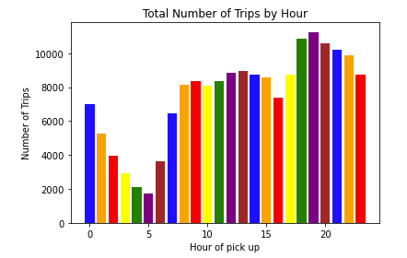
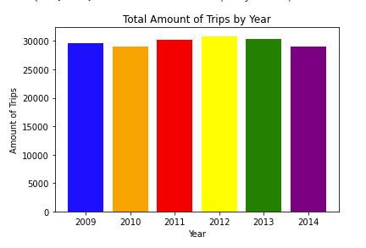
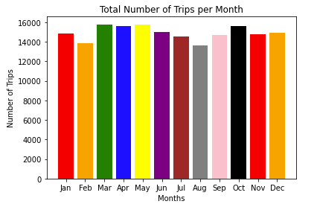
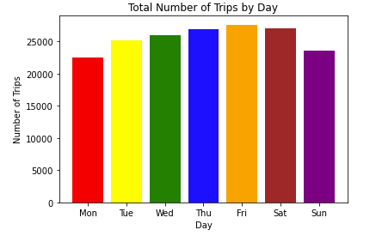
Time/Date

Slide 8
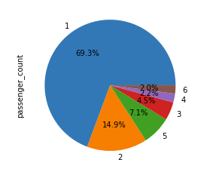
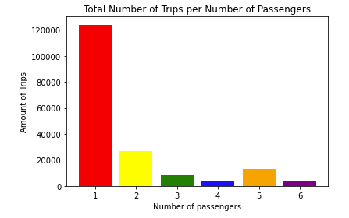
Cost

Slide 9
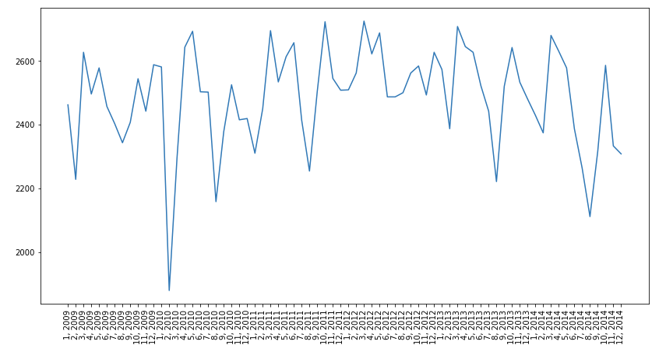

Slide 10
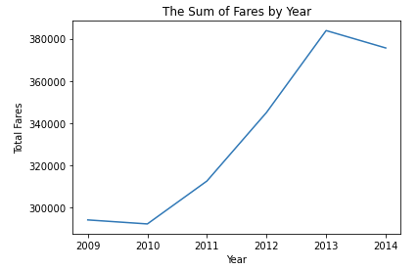
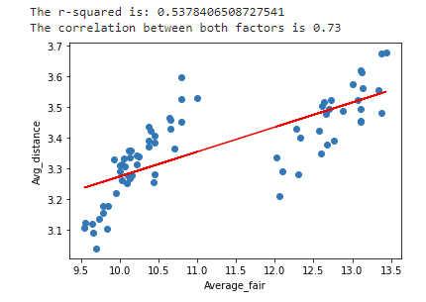
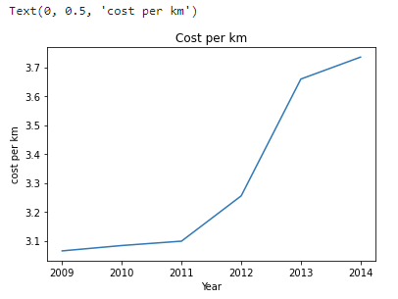
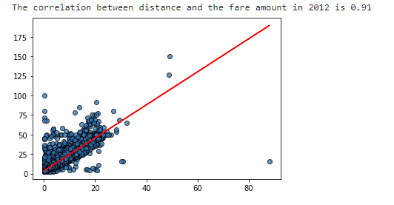
Distance

Slide 11
Final Dataframes

Slide 12
Conclusions and Implications

